Slide 1
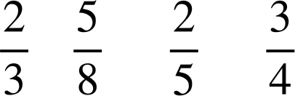
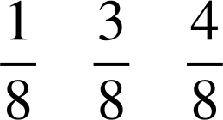
Calculating theoretical probabilities from lists (one event)
Task A: Finding probabilities of events with spinners
1) Here are four win/lose spinners.
A
a) For each spinner, find the probability that it lands on ‘win’ in a single spin.
win
win
B
lose
win
win
win
A:
B:
C:
D:
lose
win
lose
Other equivalent fractions, decimals or percentages may be used.
lose
win
C
b) Sofia wants to choose the spinner that gives her the best chance of winning. Which spinner should she choose?
win
lose
D
lose
win
lose
win
lose
spinner D
win
win
c) Which spinner is least likely to land on win?
spinner C
2) Alex, Jun and Sam spin the spinner 40 times in total. They get a point every time the spinner lands on their name.
a) Who should expect to get the most points? b) Who should expect to get the fewest points?
c) What is the probability the spinner lands on Alex?
d) What is the probability the spinner lands on Jun?
e) What is the probability the spinner lands on Sam?
Jun
Sam
Sam
Alex
Sam
Alex
Jun
Sam
Sam
Jun
Other equivalent fractions, decimals or percentages may be used.
f) How many more points should Sam expect to get compared to Alex?
g) Will your answer to (f) necessarily happen when they spin the spinner? Explain your answer.
of 40 = 20
of 40 = 5
20 − 5 = 15
No. These results are only theoretical. The actual results may differ due to chance.

Slide 2


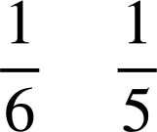
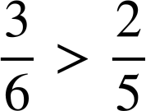
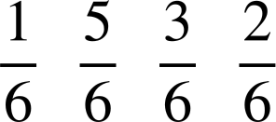
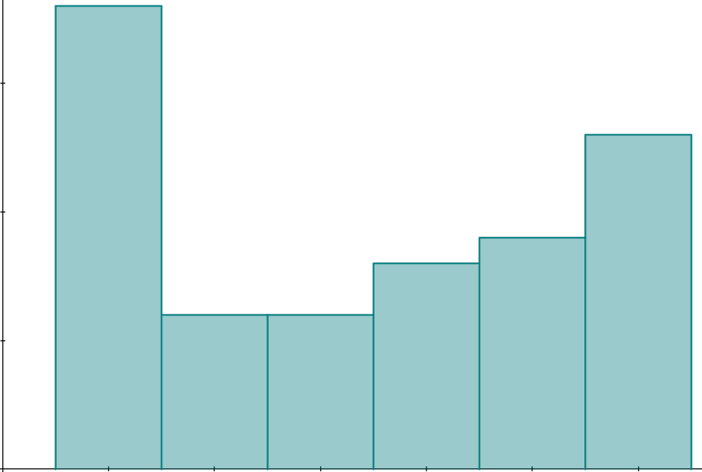
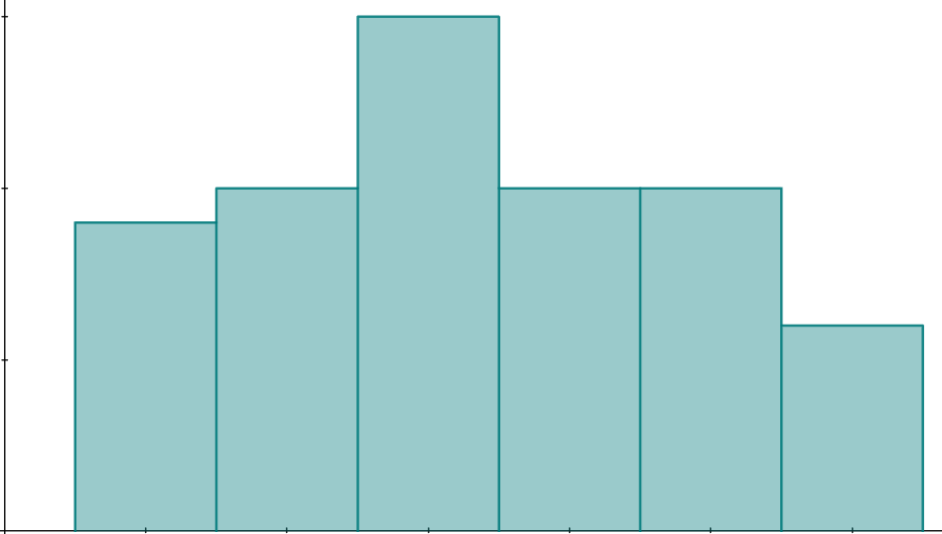
Calculating theoretical probabilities from lists (one event)
Task B: Finding probabilities of events
1) Andeep and Lucas each have a deck of cards spelling out their own name. They play a game where they each randomly select a card from their deck, record the letter and then return the card to the deck.
A
N
D
E
E
P
L
U
C
A
S
They win a point if they draw a card containing the letter A.
a) What are the probabilities for each player winning a point?
Andeep:
Lucas:
Lucas
b) Who is most likely to get a point when they select a card?
c) They change the rules so that they get a point if they select a vowel. Who is most is most likely to get a point with these rules? Explain your answer.
Andeep
The probability that Andeep picks a vowel is while the probability that Lucas picks a vowel is and .
or
The probability that Andeep picks a vowel is a half, while the probability that Lucas picks a vowel is less than a half.
2) A regular six-sided dice is rolled. Find the following probabilities.
a) P(3) =
b) P(4) =
c) P(not 4) =
d) P(even) =
e) P(odd) =
f) P(multiple of 3) =
g) P(7) =
0
h) P(not 7) =
i) P(factor of 60) =
1
1
Other equivalent fractions, decimals or percentages may be used.
j) The dice is rolled 60 times. Approximately how many times could it be expected to land on the number 3, based on its probability?
of 60 = 10
k) Will your answer to part (j) necessarily happen? Explain your answer.
No. The probability only provides a theoretical expectation.
20
20
15
15
frequency
frequency
Examples from the simulation:
10
10
5
5
0
1
2
3
4
5
6
0
1
2
3
4
5
6
Mathematics in Education and Industry
v2.3

